Slide 1



Predicting Heart Diseases In Medical Patients
The Society

Slide 2
Our Goals Using This Data
“The dataset we chose was the Heart Disease dataset provided by UCI Machine Learning Repository. The dataset column to be tested will be the “target” column which will tested against the remaining columns to determine if we will be able to predict which patients will have heart diseases and if we are able to predict these cases. Through our different process methods, we hope to identify which will provide us the best results.”
- The Society

Slide 3
Process Methods
02. Logistic Regression
04. Reducing Errors
01. Data Visualization
03. Data Balancing
05. Random Forest Classifier
Notes:
Data visualization – Seeing how the CSV is imported into the dataframe
Logistic Regression – Our first machine learning model used for supervised learning classification
Data Balancing – passing the equal numbers of 1/0 (targets through our dataset)
Reducing errors – reducing errors
Random Forest Classifier – Decision tree-based learning

Slide 4
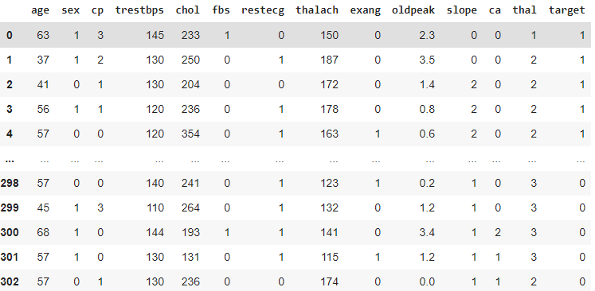
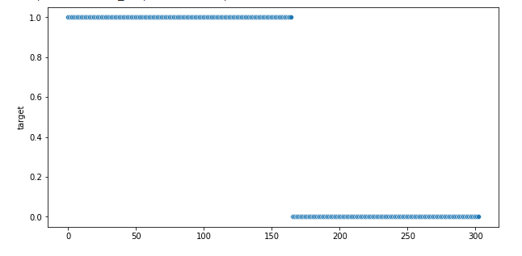
Data Visualization
Original DataFrame from – Heart.Csv
Scatter plot of our target column (heart disease)
Comparison for Heart Disease or not
Notes:
Looking at our data set imported into a dataframe and then a scatter plot. The first issue we noticed was that the dataset organized those with heart diseases first and those without last.
age
sex
chest pain type (4 values)
resting blood pressure
serum cholestoral in mg/dl
fasting blood sugar > 120 mg/dl
resting electrocardiographic results (values 0,1,2)
maximum heart rate achieved
exercise induced angina
oldpeak = ST depression induced by exercise relative to rest
the slope of the peak exercise ST segment
number of major vessels (0-3) colored by flourosopy
thal: 3 = normal; 6 = fixed defect; 7 = reversable defect
Dataset is from Kaggle but originally from the uci archive

Slide 5
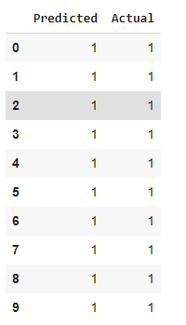
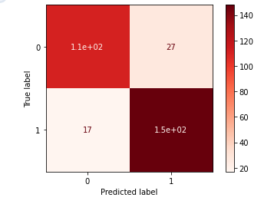
Logistic Regression
Confusion Matrix (Logistic Regressions)
Actual vs. Predicted Model accuracy (top 10)
The confusion matrix gives us those that are correct versus those predictions that were wrong
Notes:
This template was inserted from Power-user, the productivity add-in for PowerPoint, Excel and Word.
Install Power-user to access thousands of templates, icons, maps, diagrams and charts with Power-user.
Visit https://www.powerusersoftwares.com/
©Power-user SAS, terms of license: https://www.powerusersoftwares.com/terms

Slide 6
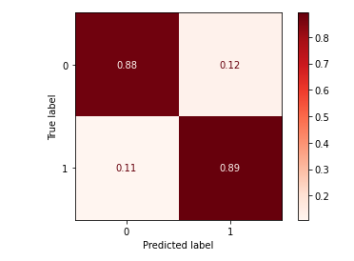
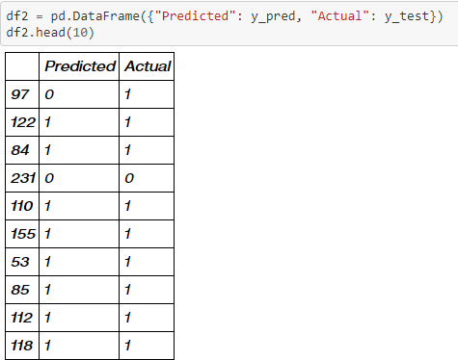
Random Forest Classifier
Applied New Random Forest Classifier model
Increase number of type 2 errors
Notes:
This template was inserted from Power-user, the productivity add-in for PowerPoint, Excel and Word.
Install Power-user to access thousands of templates, icons, maps, diagrams and charts with Power-user.
Visit https://www.powerusersoftwares.com/
©Power-user SAS, terms of license: https://www.powerusersoftwares.com/terms

Slide 7
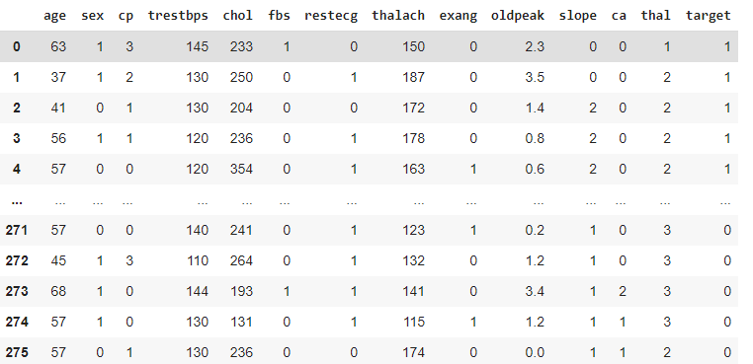
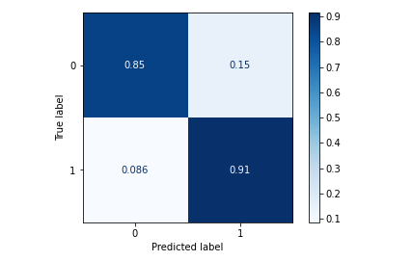
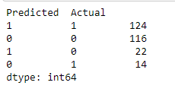
Data Balancing
Ensuring the same number of positives and negatives were passed to the train model
Compared these results to the original logistic regression model
Reduced the Type 2 errors 0.086 (14)
Notes:
This template was inserted from Power-user, the productivity add-in for PowerPoint, Excel and Word.
Install Power-user to access thousands of templates, icons, maps, diagrams and charts with Power-user.
Visit https://www.powerusersoftwares.com/
©Power-user SAS, terms of license: https://www.powerusersoftwares.com/terms

Slide 8
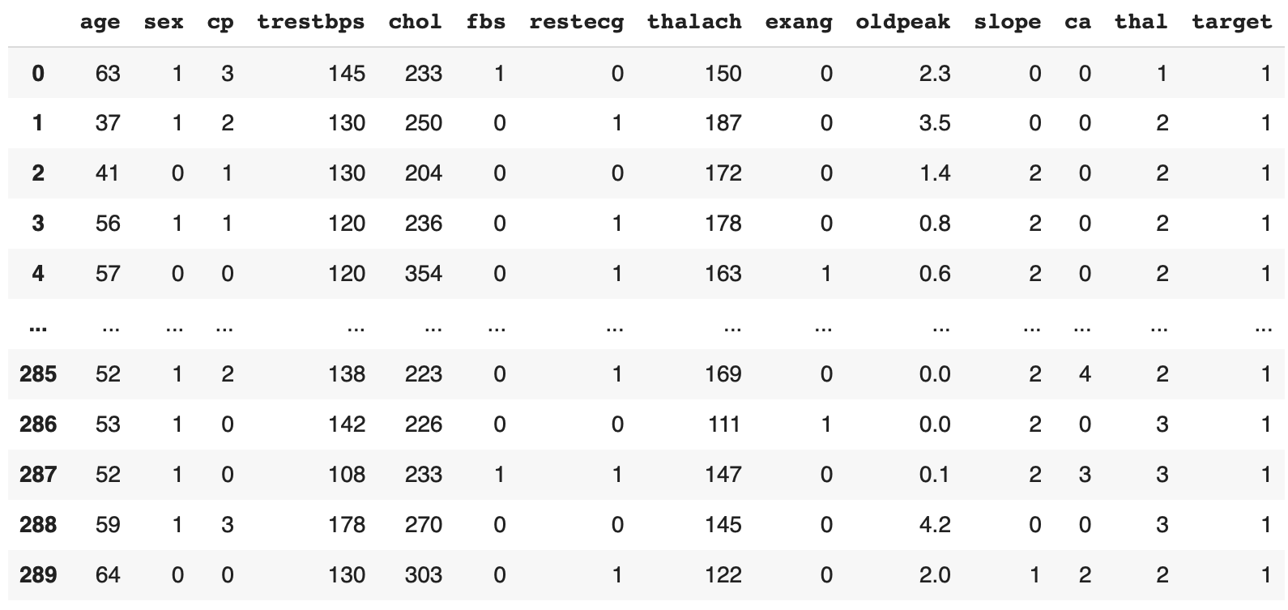
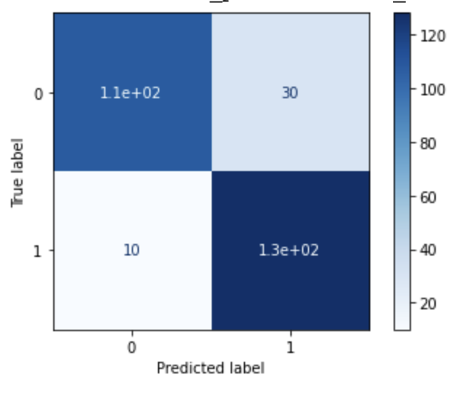
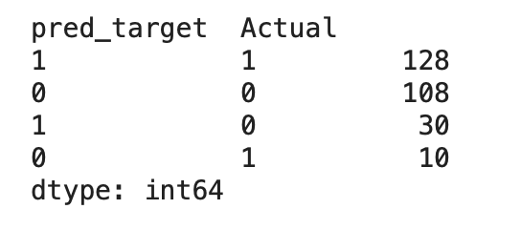
Reducing Errors
Adjusting the Process
Feedback wrong predictions to data frame and train the model again
Testing model against original Dataframe
Compare Type 2 error to previous result
Notes:
This template was inserted from Power-user, the productivity add-in for PowerPoint, Excel and Word.
Install Power-user to access thousands of templates, icons, maps, diagrams and charts with Power-user.
Visit https://www.powerusersoftwares.com/
©Power-user SAS, terms of license: https://www.powerusersoftwares.com/terms

Slide 9
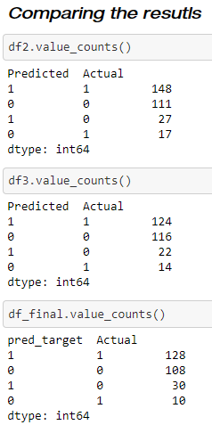
Conclusion
Tables from the different models results
Notes:
This template was inserted from Power-user, the productivity add-in for PowerPoint, Excel and Word.
Install Power-user to access thousands of templates, icons, maps, diagrams and charts with Power-user.
Visit https://www.powerusersoftwares.com/
©Power-user SAS, terms of license: https://www.powerusersoftwares.com/terms

Slide 10
Questions?

